Slide 1
Library Initiative
Youth Ambassador for Angelique Foundation
Showcase what anand has done being the Youth Ambassador
What he did as an intern

Slide 2
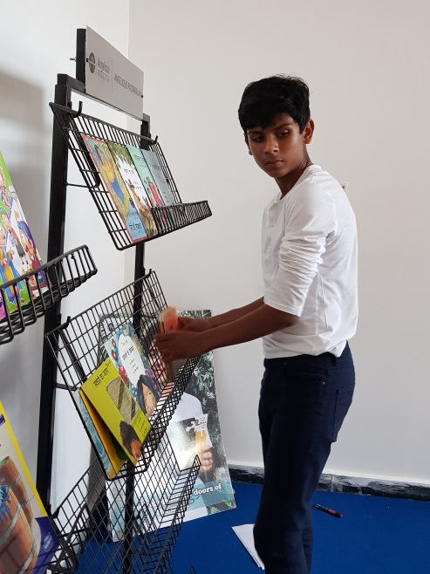
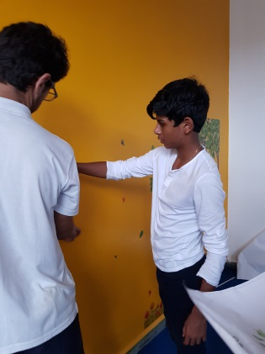
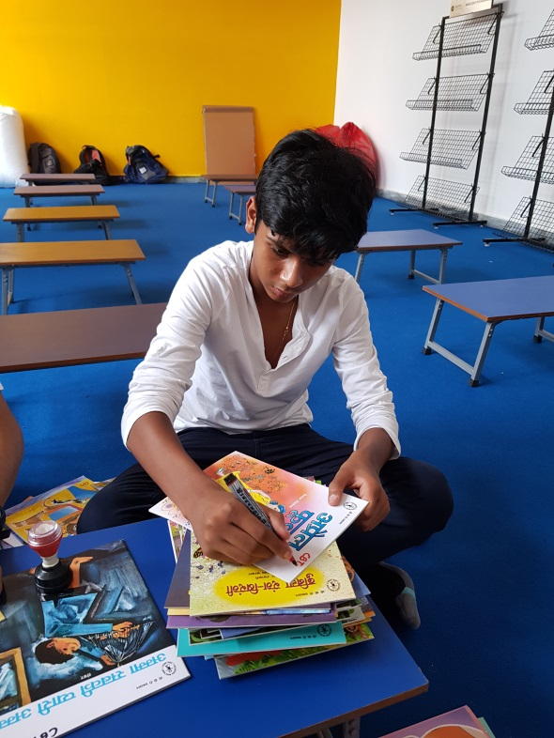

Slide 3
Reading to the mind is what gymnasium is to the body
Imagine if you could not read road signs
Imagine of you could not comprehend what you read in the newspaper
Imagine if you could not express your thoughts

Slide 4
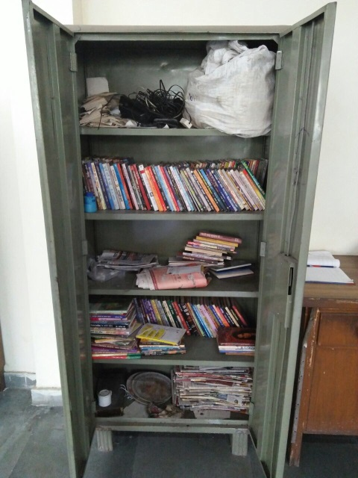
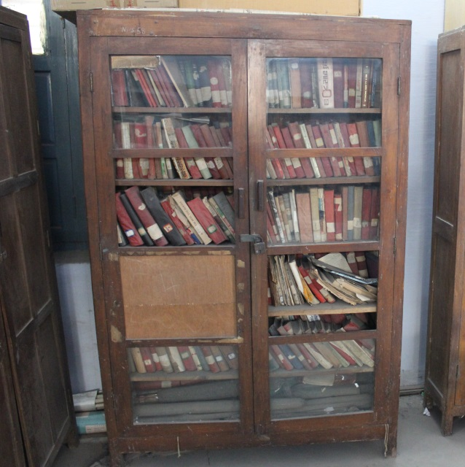
A child who read is an adult who thinks... and
Ninety percent of the low income group schools do not have libraries
If they do, the libraries have dusty rusty books in closed cupboards, most of them above the literacy levels of the students
Such libraries create a deep understanding in the students – I CANNOT READ A STORY BOOK
Below are pictures of low-income group school libraries

Slide 5
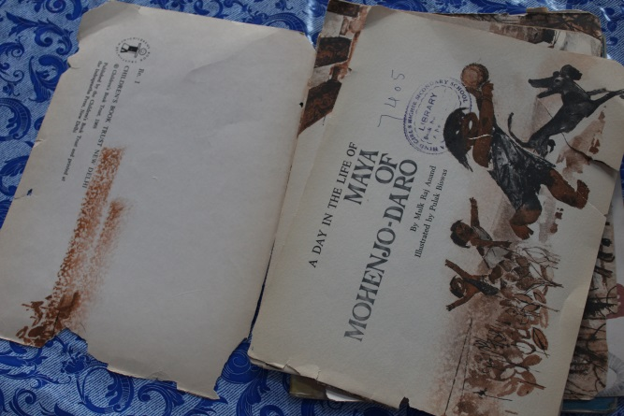
Need for DONATING a Library in low income group schools
The library is the last option during budget distribution in low income schools
Most of the books are donated by publishers or people. The donated books do not match the literacy level of the students
Reading levels among the children is poor as the emphasis is on rote learning.
Lack of colourful illustrations in the books further reduce comprehension
The children either read or comprehend
Adult intervention has created a fear of failure among the children.
A lack of an environment where children can read at their own pace, select the books they want to read without being judged or graded.

Slide 6
Need for a library in NDMC Primary School – Kamraj
The students did not have the freedom to read
Reading is being done in a controlled environment where teachers read the stories in class.
The few story books are overused and read many times.
Many of the books were beyond the literacy levels of the students.
The books also came from only two or three publishers thus leading to limited reading options.
What is also lacking is a motivating environment for reading.

Slide 7
Proposed Library
libraries create the missing joy for reading, illustrations increase comprehension and age appropriate books with large fonts and less text lead to psychological acceptance coupled with a comfortable and attractive environment where children could read
Little adult intervention
Arthur Foot Academy kids reading
NDMC libraries kids reading

Slide 8
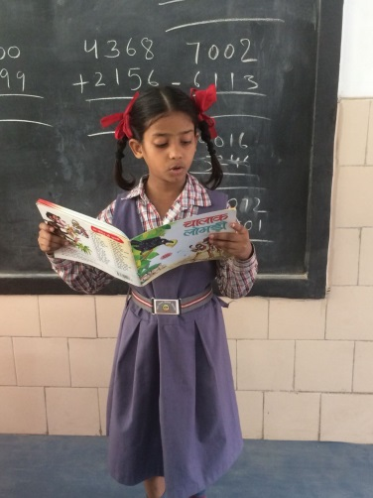
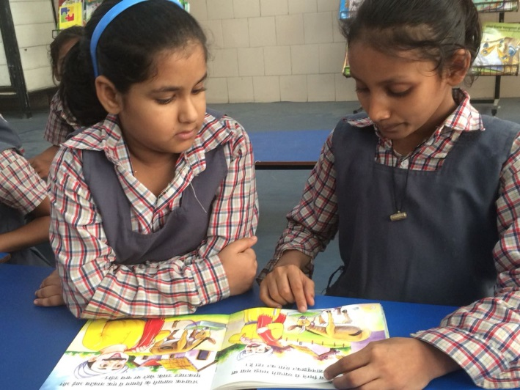
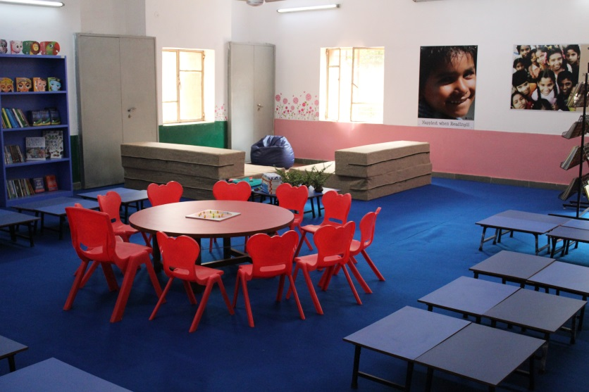

Slide 9
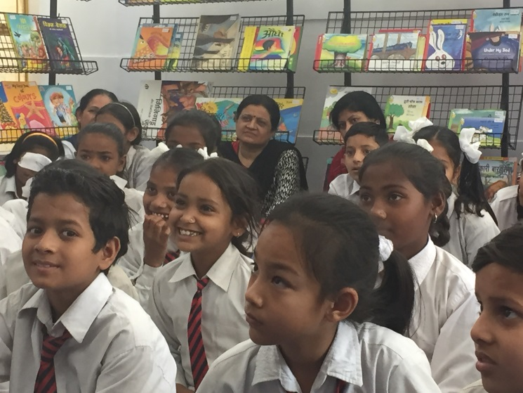
Aims in establishing the library
Developing a love for reading
reducing the gap between a child and a book
Developing a habit of reading by providing a comfortable environment,
attractive books meeting all literacy levels,
colourful illustrations supporting comprehension and reducing adult interventions.
3. Making a child read independently and hence confidently.
Making books children’s friends.
Eventually this would help the Foundation reach the level where children read books fluently for their age,expressedthemselvesverballythroughshortstoriesorthoughillustratingstories.
PIC OF KIDS READING; HAPPY KIDS

Slide 10
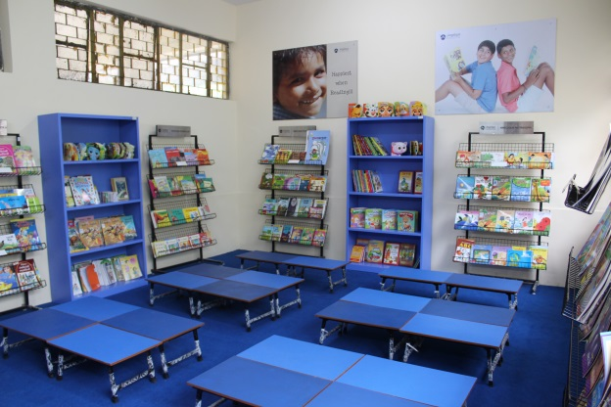
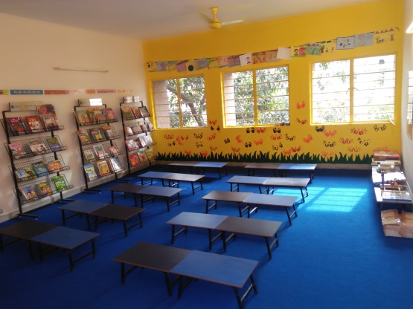
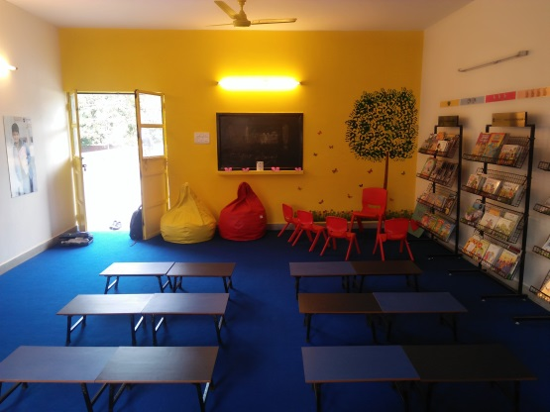
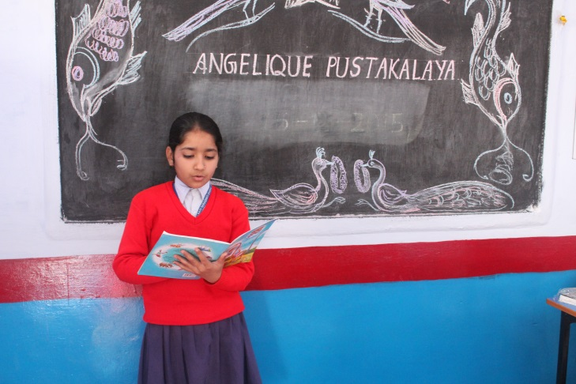
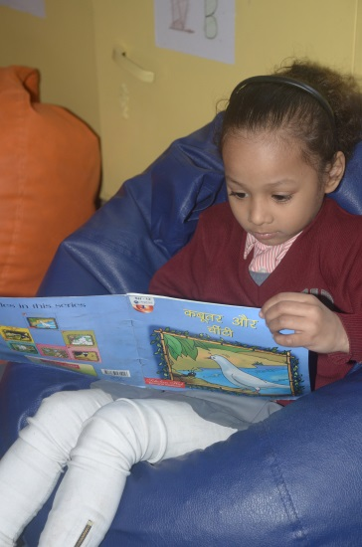
Completed Project pics
Pics of library
Pics of kids reading

Slide 11
Due Diligence
School is a legal entity
Required Papers
Initial Survey Form
Request Letter
School Registration Document
Copy of 12A and 80G certificate copy if available
Copy of Pan Card

Slide 12
Due Digilence
About the school
Initial survey form LINK TO SURVEY FORM
Literacy Level Assessment
reading sessions in classrooms

Slide 13
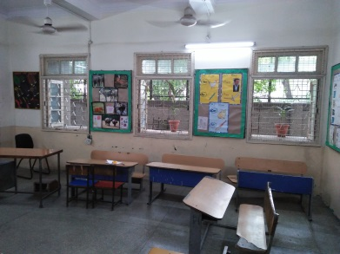
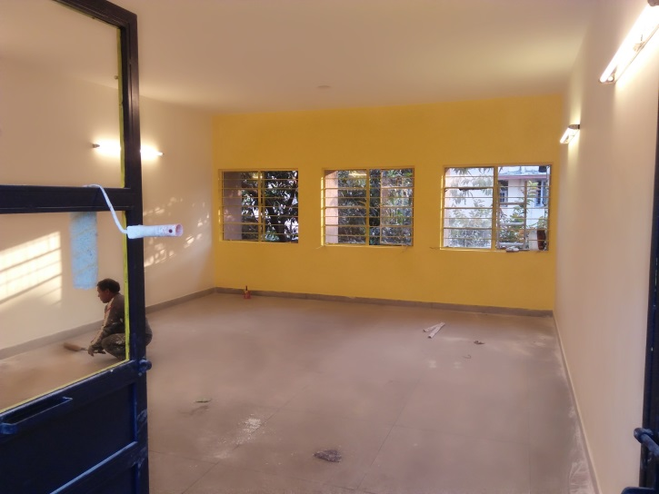
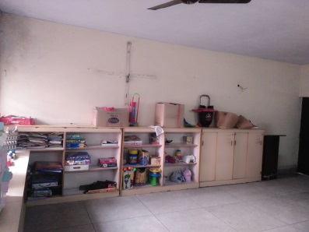
Proposed Library Room
Selecting a room
Lights, fans, natural light, lockable windows and doors, at least 300 sq feet
Assess the civil work to be done
Repairing A BEFORE PIC OF A LIBRARY ROOM
Painting

Slide 14
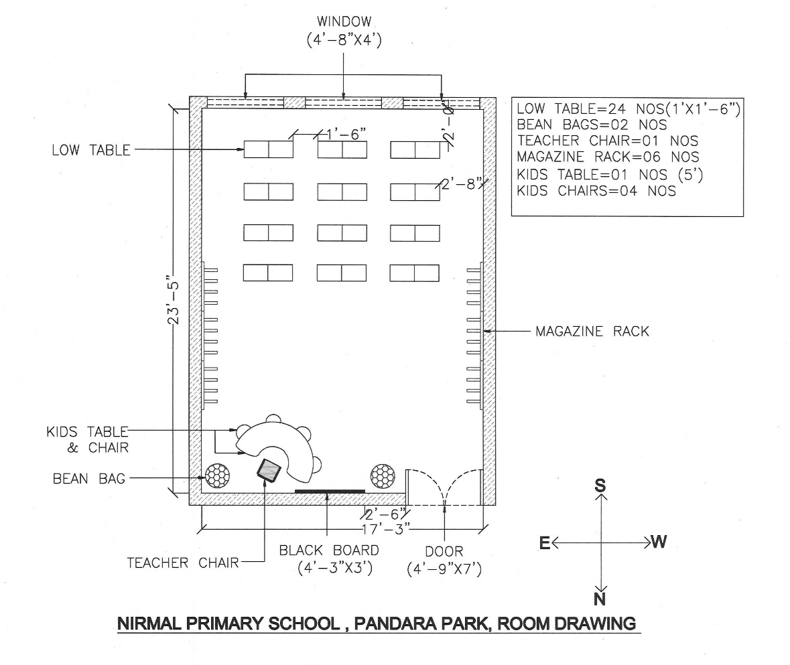
Drawing of the room
Layout of the empty room
Measurements INSERT ANY AUTOCADD DRAWING

Slide 15
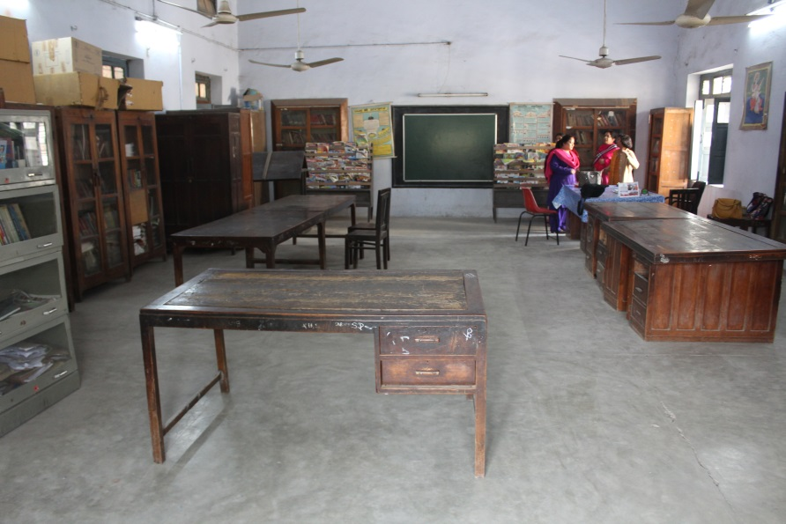
Civil work
List of civil works to be done by the school
Electrical works to be competed by the school
Any other changes to be made by the school
Estimate of the paint work
PIC OF A BEFORE ROOM

Slide 16
Design the Library
Layout of the room AN AUTOCADD DRAWING AND A COMPLETED PIC THE SAME ROOM. ONE OF THE SIMPLE LIBRARY – NIRMAL PUBLIC SCHOOL
Book shelves
Low tables
Posters
Bean bags
Teacher’s chair
Dustbin
Cognitive wooden puzzles
Colour of the walls

Slide 17
Fund Raising
Costing of the carpet and furniture based on the layout
Costing of the books and cognitive wooden puzzles based on the survey form and literary assessment effort
COSTING TABLE OF THE SAME LIBRARY

Slide 18
Bill of Quantity
Sl.No. | Particulars | Price | Quantity | Total
1 | Poster_2 (3 by 2) | 998 | 6 | 5990.4
2 | SS Plats - 21x5 | 992 | 6 | 5952
3 | Bean Bags | 1300 | 2 | 2600
4 | Wall Stickers | 250 | 3 | 750
5 | Name plates | 40 | 6 | 240
6 | Books | 25000 | 1 | 25000
7 | Magazine Racks | 4324 | 6 | 25944
8 | Blue Low Floor Tables - 23.5x14.5 | 590 | 24 | 14160
9 | SS plate- Inauguration | 3500 | 1 | 3500
10 | little Genius Puzzles | 450 | 10 | 4500
11 | Blue Floor Carpet (Sq. Feet) | 15387.0 | 1 | 15387
12 | Colurs | 200.0 | 5 | 1000
13 | D Table | 10000.0 | 1 | 10000
14 | Kids chair | 360.0 | 5 | 1800
15 | Teachers Chair | 500 | 1 | 500
16 | LED | 700 | 4 | 2800
 |  |  |  | 120123.4

Slide 19
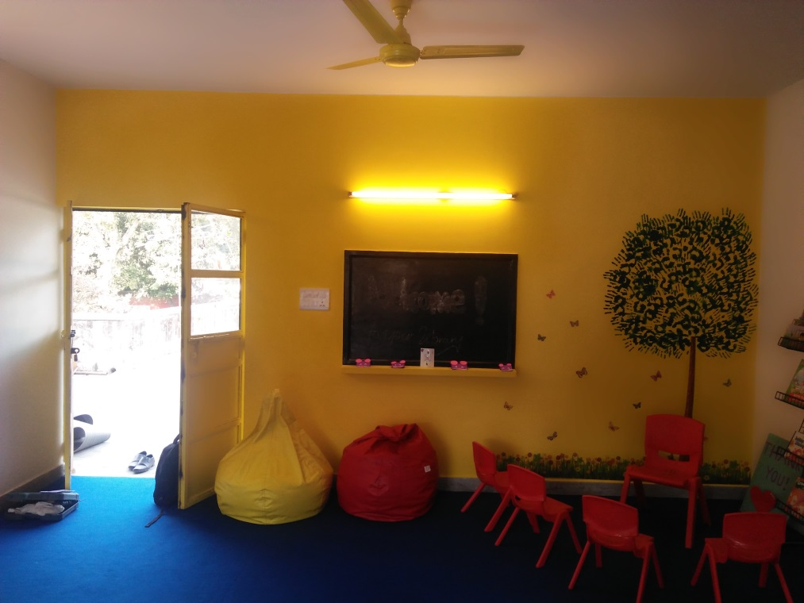
Painting and Civil Work
Start civil works and paint jobs
To be completed a week before the materials will be delivered as the lingering paint smell can be harmful
Any wall stickers or hand painting jobs to be completed
PIC OF THE TREE AND BUTTERFLIES OF NIRMAL

Slide 20
Ordering the Materials
Items quantity supplier delivery date MAKE THIS TABLE ACCORDIGN TO NIRMAL
Sl.No. | Particulars | Vendor Name | Days to procure
1 | Poster_2 (3 by 2) | UAMS Advertising Solutions | 5 days
2 | SS Plats - 21x5 | UAMS Advertising Solutions | 7 days
3 | Bean Bags | Local Vendor at Panchkuian Road | 1 day
4 | Wall Stickers | Online Shop ( flipkart) | 7 days
5 | Name plates | Jain Stationary | 7 days
6 | Books | Eureka Books | 15 days
7 | Magazine Racks | Supreme Furnishers | 10 days
8 | Blue Low Floor Tables - 23.5x14.5 | Rajpura Steel Works | 10 days
9 | SS plate- Inauguration | UAMS Advertising Solutions | 5 days
10 | little Genius Puzzles | Little Genius Puzzles | 15 days
11 | Blue Floor Carpet (Sq. Feet) | Maharaja Rexine | 7 days
12 | Colurs | Stationary Shop | 1 day
13 | D Table | Trends Furnishers | 15 days
14 | Kids chair | Rajpura Steel Works | 5 days
15 | Teachers Chair | Rajpura Steel Works | 5 days
16 | LED | Electrical shop | 1 day

Slide 21
Materials Collect on Site
Transport and collect all the materials at school site, inside library room.

Slide 22
Day 2
Team A – 4 persons – half a school day
Stick the remaining carpet on top of the foam
Team B – 4 persons – half a school day
Put up the posters and placard
Team C – 4 persons – half a school day
Place the furniture according to the layout designed

Slide 23
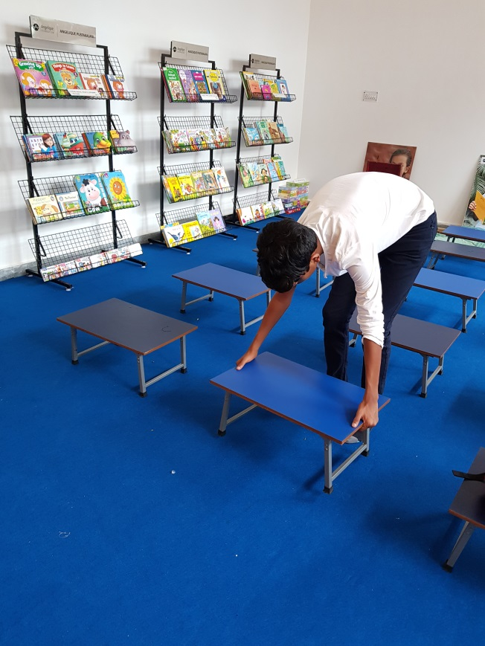
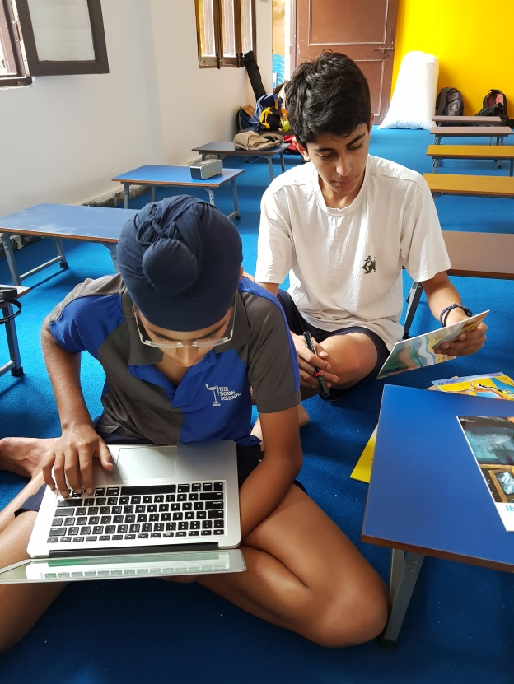
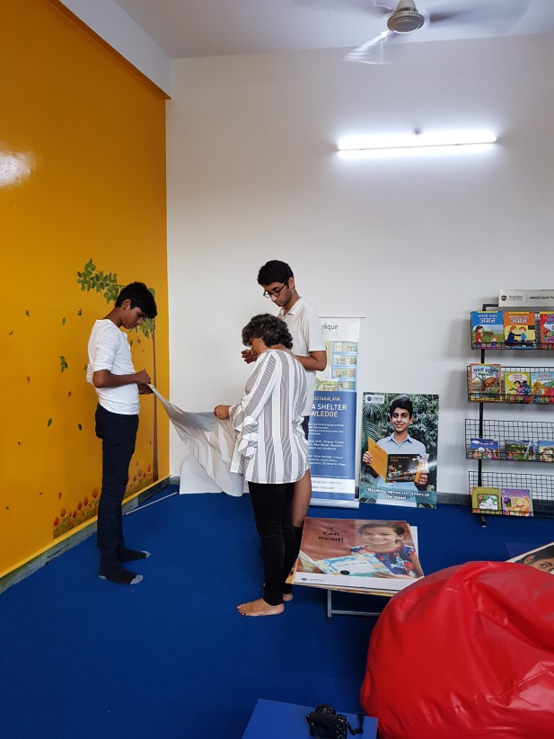
All Teams – half a school day PICS OF KIDS AT WORK IN ARTHUR FOOT SCHOOL

Slide 24
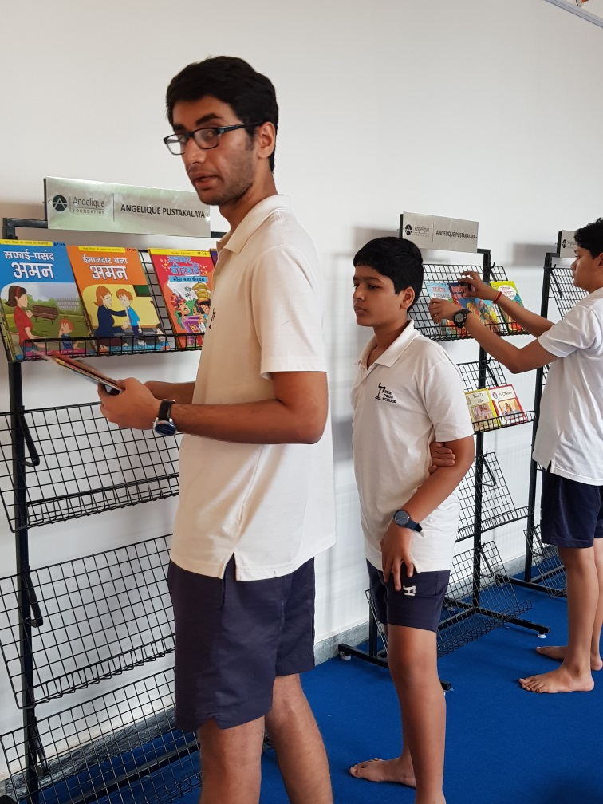
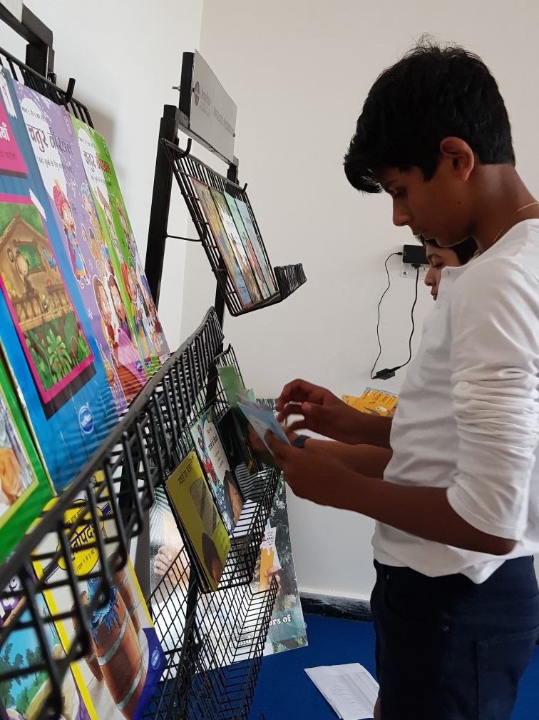
Place the books in the book racks

Slide 25
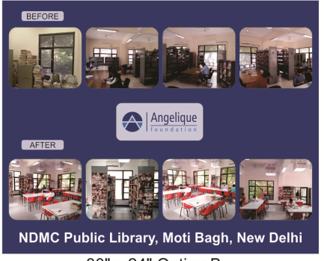
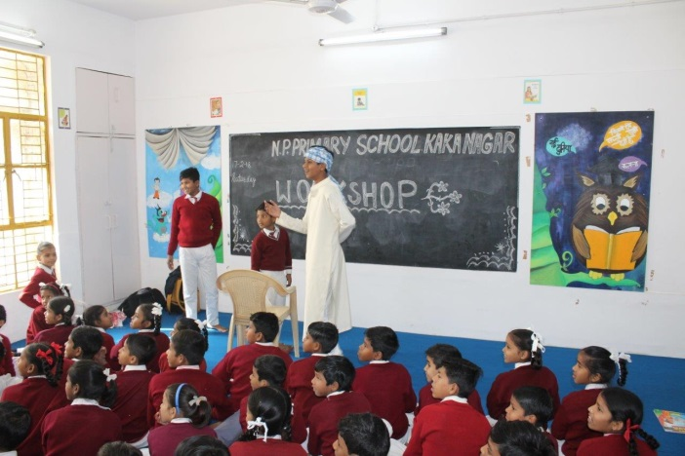
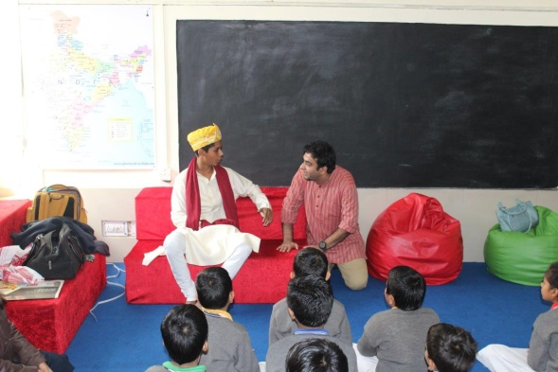
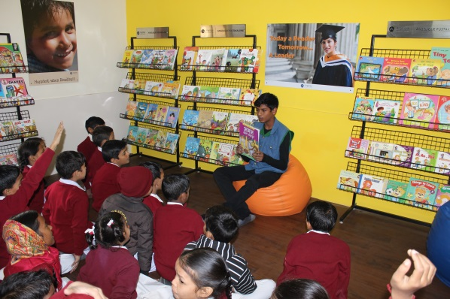
Day 3
Make new teams
Clean the room
Take photographs of the library
Create a ‘Before and After’ poster PIC OF A POSTER
Plan the inauguration / Inaugurate the library
Book reading
Enact books PICS OF ANAND IN WORKSHOPS
Illustrate stories
Songs

